Slide 1
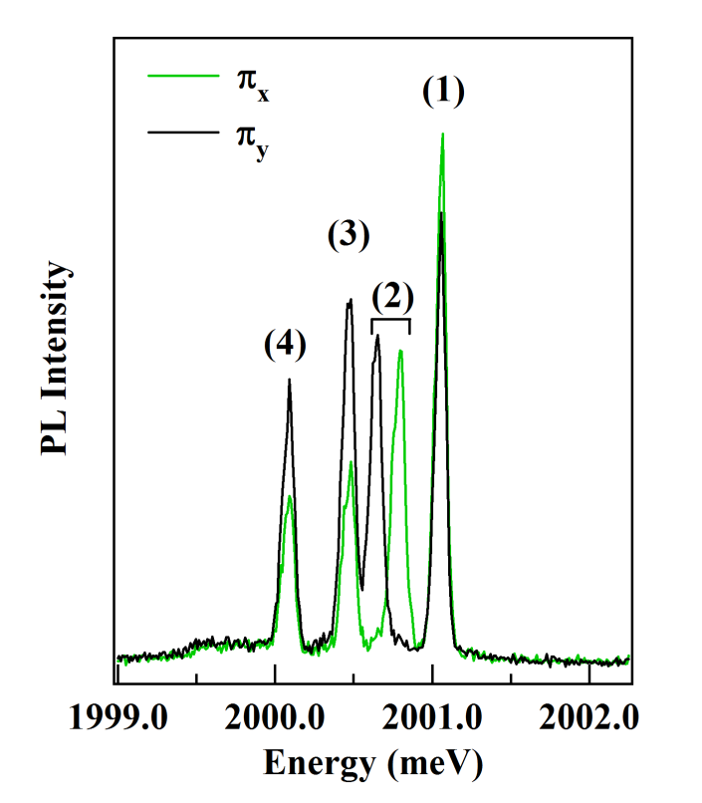
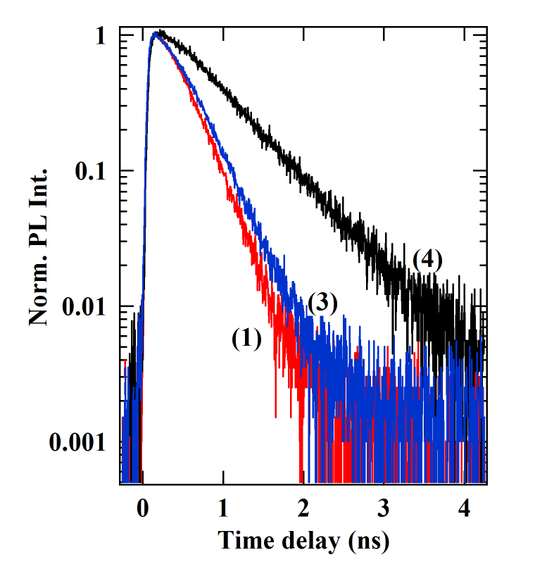
(a)
(c)
E
I-1>
I+1>
X-Cr
I±1>
σ+
σ−
(b)
π_{y}
π_{x}
D₀
Cr
0
S_{z}=+1
S_{z}=0
S_{z}=-1

